Slide 1
Employee Data Analysis using Excel
STUDENT NAME: DHARSHINI C
REGISTER NO: 312217109
NAAN MUDHALVAN ID: CC49FEB5D800227A6B34C42D19322CE9
DEPARTMENT: B COM ( COMPUTER APPLICATION )
COLLEGE NAME: SHRI KRISHNASWAMY COLLEGE FOR WOMEN

Slide 2

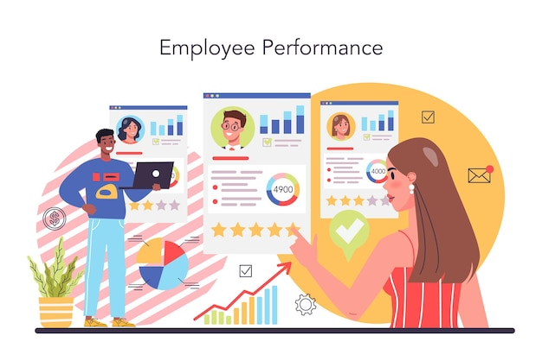
PROJECT TITLE
Employee Performance Analysis using Excel

Slide 3


AGENDA
Problem Statement
Project Overview
End Users
Our Solution and Proposition
Dataset Description
Modelling Approach
Results and Discussion
Conclusion
3/21/2024 Annual Review

Slide 4

PROBLEM STATEMENT
Subjective and based performance
evaluations and increments.
Inconsistent and inaccurate assessment methods.
Poor talent identification and development.
Low employee engagement and retention.
Limited data-driven decision making.
GOAL : Develop a data-driven employee performance
Analysis solution for accurate and objective insights.

Slide 5

PROJECT OVERVIEW
Analyse employee performance to inform talent
Management and organizational decisions.
KEY OBJECTIVES :
Evaluate employee performance.
Identify areas of improvement.
Inform talent management.
DELIVERABLES :
Employee performance report , Development plans.

Slide 6



WHO ARE THE END USERS?
HR MANAGERS : Manage talent and development
Programs.
LINE MANAGERS : Supervise and evaluate employee
Performance.
EMPLOYEES : Understand their strengths and areas for
Improvements.
SENIOR LEADERSHIP : Make strategic decisions based on
Performance data.

Slide 7
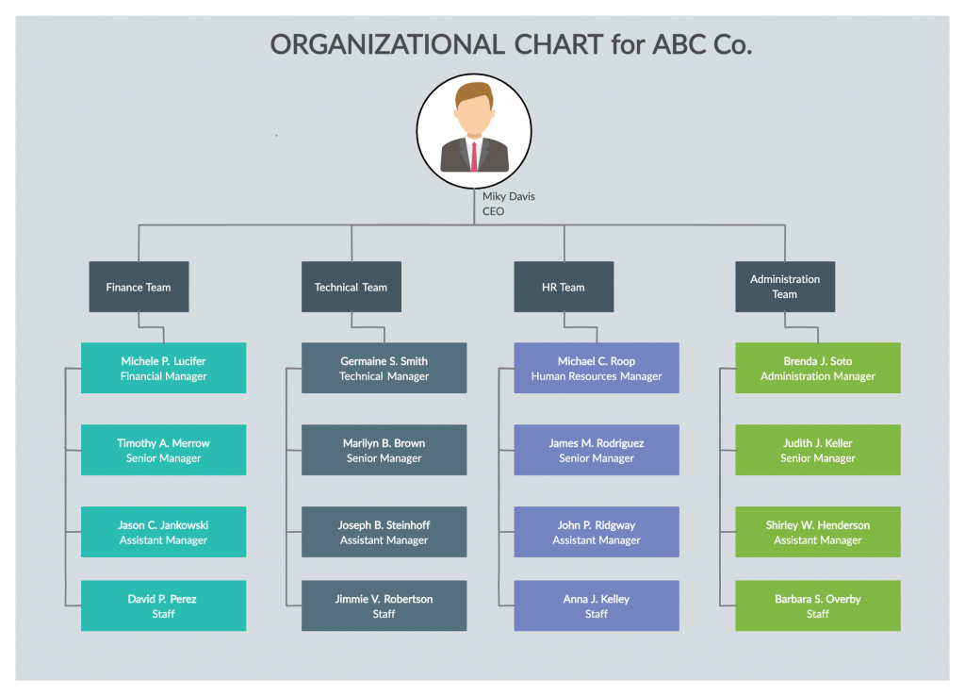



Slide 8

OUR SOLUTION AND ITS VALUE PROPOSITION
CONDITIONAL FORMATTING-MISSING: This involves using conditional formatting
to visually highlight cells that are empty or contain blank values.
FILTER-REMOVE: This refers to filtering out or highlighting data entries that
have missing or blank values.
PIVOT TABLE: A tool used to summarize, analyze, explore, and present data,
allowing you to reorganize and manipulate large data sets.
CHART: This refers to creating visual representations of data, such as bar charts,
pie charts, or line graphs, to analyze trends or patterns.

Slide 9
Dataset Description
EMPLOYEES-KAGGLE
29-FEATURES
9-FEATURES
EMPLOYEES ID-NUMERICAL VALUES
NAME-TEXT
EMPLOYEES TYPE
PERFORMANCE LEVEL
GENDER-FEMALE,MALE
EMPLOYEE RATING-NUMERICAL VALUES

Slide 10

THE "WOW" IN OUR SOLUTION
PERFORMANCE LEVEL=IFS(Z8>=5,”VERY
HIGH”,Z8>=4,”HIGH”,Z8>=3,”MEDIUM”,
TRUE,”LOW”)
3/21/2024 Annual Review
10

Slide 11
MODELLING
DATA COLLECTION:
I collect the data in edunet dashboard. Employee data entered and open the file and
analyze the employees performance .
FEATURE COLLECTION:
“Employee performance analysis features include goal-setting, performance metrics, regular
feedback, rating systems, competency assessments, development planning, and data-driven insights
to evaluate and improve employee performance”.
DATA CLEANING:
Data cleaning in employee performance analysis involves identifying and correcting inaccuracies, inconsistencies, and missing values in performance data to ensure reliable insights and fair evaluations.
11

Slide 12
PERFORMANCE LEVEL:
Performance level in employee performance analysis refers to the categorization of employees into distinct groups based on their job performance, such as high performer, meets expectations, needs improvement, or underperformer.
SUMMARY:
A summary in employee performance analysis provides a concise overview of an individual's strengths, weaknesses, achievements, and areas for improvement, highlighting their overall performance and potential for growth.
VISUALIZATION:
Visualization in employee performance analysis involves using charts, graphs, and other visual tools to represent complex performance data, making it easier to identify trends, patterns, and insights that inform performance management decisions.

Slide 13
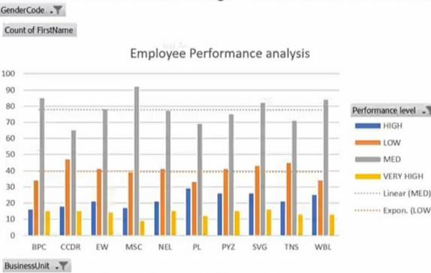
RESULTS
13

Slide 14
conclusion
Conclusions in employee performance analysis involve summarizing key findings, identifying areas for improvement, and recommending development opportunities, ultimately guiding decisions on promotions, training, and performance enhancement initiatives.

